Slide 1
The World Wide Web

Slide 2
Markup language
A markup language is a computer language that is used to apply layout & formatting conventions to a text document.

Slide 3
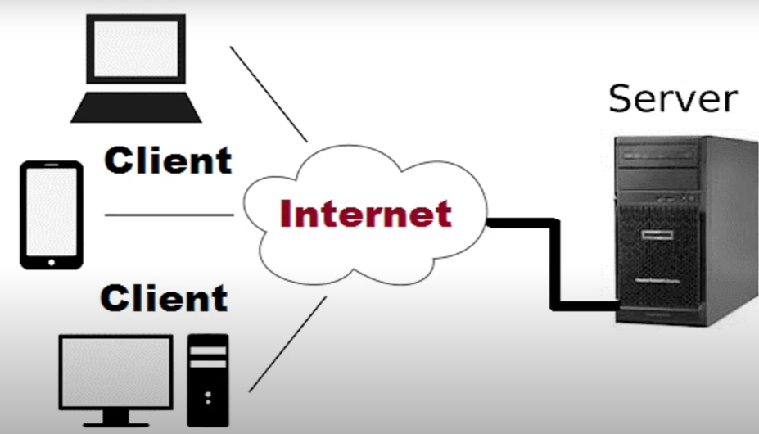

Slide 4
Four types of languages used in web development:
Markup languages: Structure content (HTML)
Style sheet languages: Control appearance (CSS)
Client-side scripting: Add interactivity in the browser (JavaScript, C# Script, VBScript)
Server-side scripting: Generate dynamic content on the server (JSP, PHP, ASP)

Slide 5
HTML
HTML, known as Hyper Text Markup Language, is the language used to create Web pages
Specifically created to make world wide web pages.

Slide 6

Web Standards
History of Web Standards: The web came into existence when the US military created a network for communication in the 1960s known as ARPANET.
ARPANET uses a method for transmitting information and it was the first network to use TCP/IP model.

Slide 7
History of Web Standards: After two decades means in 1980, the concept of transmission of data among different nodes through linking was given by Tim Berners-Lee.
In the year 1990, he made all the necessary arrangements to implement the first model of the web.
It consists of HTTP protocols, HTML for creating web pages and a web browser to view web pages, and lastly an HTTP server. This is how the web started

Slide 8
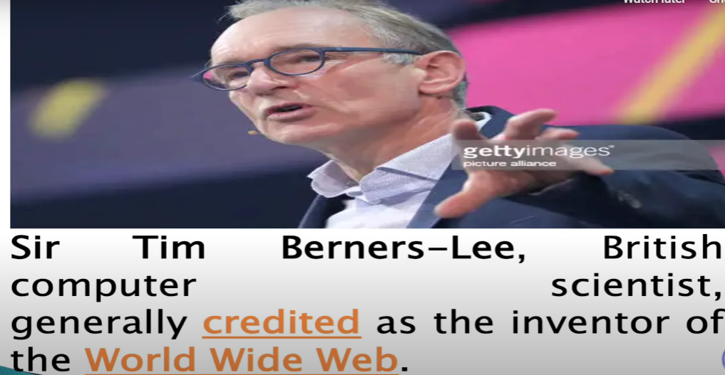

Slide 9
Web Standards
Web Standards are defined as technologies that are used in building websites.
It provides complete information on how web technology should work.
Now people use different types of devices like mobile phones, tablets, laptops, desktops, etc.
There are even more devices like interfaces that provide in-vehicle navigation and health care etc
Screen sizes are different and different operating systems.

Slide 10
Need for Web Standards
Hence it becomes a need to make certain standards while developing websites so that those websites work smoothly on all devices with different configurations.
Web standards form the foundation of rules and regulations for the developers for developing websites.
Therefore in 1994, WWW Consortium (W3C) was founded by Tim Berners-Lee and collaborated with many different IT organizations to work on making the standards/governing rules for web development.

Slide 11
Open Standards
►Tim Berners-Lee and representatives of the W3C had given the most precious feature of Web Standards_which says that the web will always be free for use .
► It will not limit itself by patent rights or licensing. Because of this feature, everyone is independent to write code for building websites without paying anything to anyone.
► Because of its openness, there is no chance of censorship means a single organization cannot control it.

Slide 12
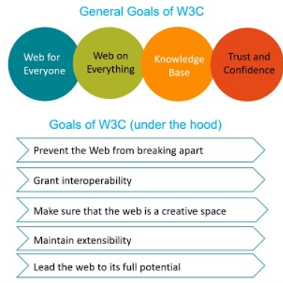

Slide 13
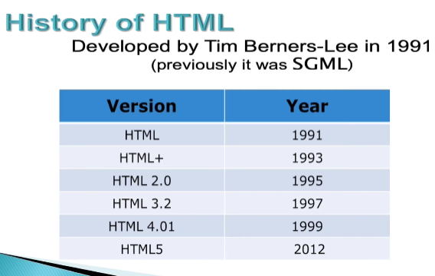

Slide 14
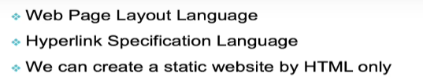
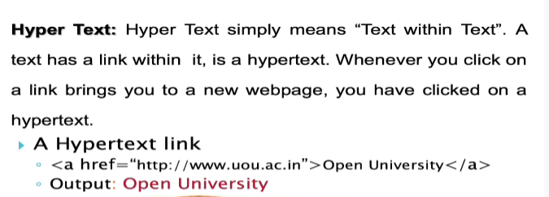
HTML

Slide 15
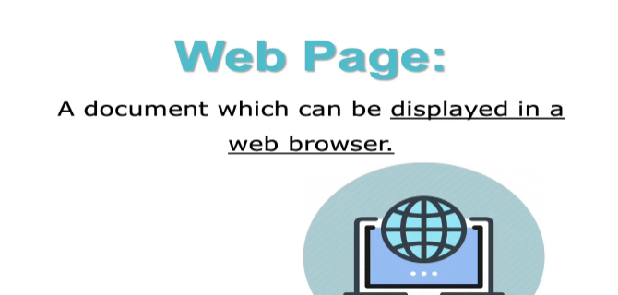

Slide 16
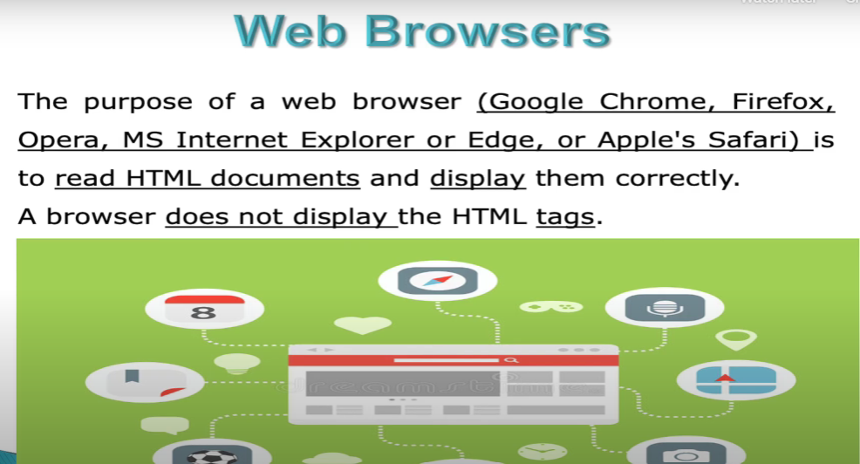
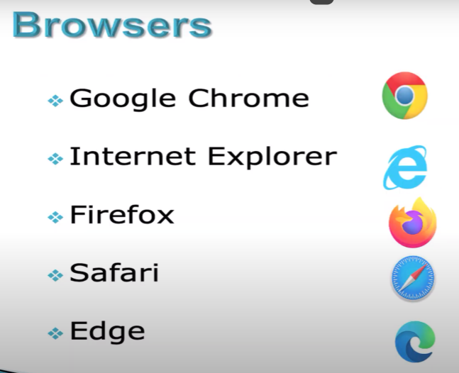

Slide 17
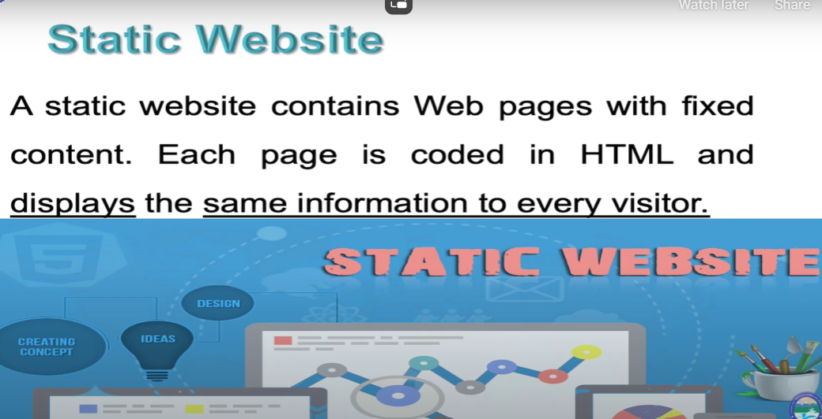

Slide 18
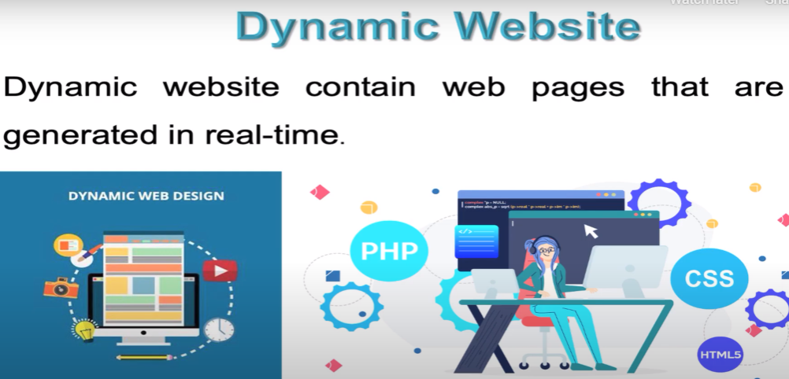

Slide 19
WWW Structure
Clients use browser application to send URIs via HTTP to servers requesting a Web page
Web pages are constructed using HTML (or other markup language) and consist of text, graphics, sounds plus embedded files
Servers (or caches) respond with requested Web page
Or with error message
Client’s browser renders Web page returned by server
Page is written using Hyper Text Markup Language (HTML)
Displaying text, graphics and sound in browser
Writing data as well
The entire system runs over standard networking protocols (TCP/IP, DNS,…)

Slide 20
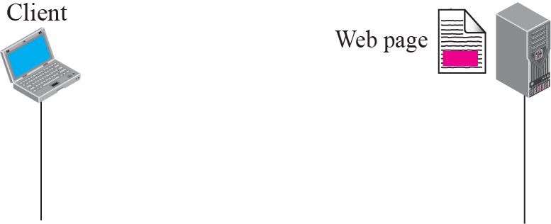
Figure 22.1 Example 22.1

Slide 21
What happens when you type a URL in the browser and press enter?
Computer sends a request to the domain name system (DNS) server to get the exact IP address of the server
The browser initiates a TCP connection with the server.
Data exchange happens using HTTP
Page is rendered in web browsers
e.g. http://example.org/home.html
Example.org is the server and IP address is such as 203.0.113.4
2. It requests service from a specific TCP port number (80) that is well known for the HTTP service

Slide 22
3. The content of HTTP request can be simple two lines
GET /home.html HTTP/1.1
Host: example.org
The computer receiving the HTTP request delivers it to web server software listening for requests on port 80. If the web server can fulfil the request it sends an HTTP response back to the browser indicating success:
HTTP/1.1 200 OK
Content:text text/html; charset=UTF-8
followed by the content of the requested page. Hypertext Markup Language (HTML) for a basic web page might look like this:
<html>
<head>
<title>Example.org – The World Wide Web</title>
</head>
<body>
<p>The World Wide Web, abbreviated as WWW and commonly known ...</p>
</body>
</html>

